Slide 1
CMPS 254
Windows
File Systems Management
Operating Systems Internals CMPS254

Slide 2
OBJECTIVES
Compare file systems supported by Windows
Differentiate Windows file systems
Describe basic components and structure of a Windows file system
Use file systems administration commands
Compare files that contain file system’s information
Mount and unmount file systems
Troubleshoot file systems
Operating Systems Internals CMPS254

Slide 3
Files/Directories in Windows
Windows organizes files and directories in a hierarchical order in each partition.
Windows has a Directory/Subdirectory/File structure
The root of the default partition is C:\ (%SYSTEMROOT%)
Operating Systems Internals CMPS254

Slide 4
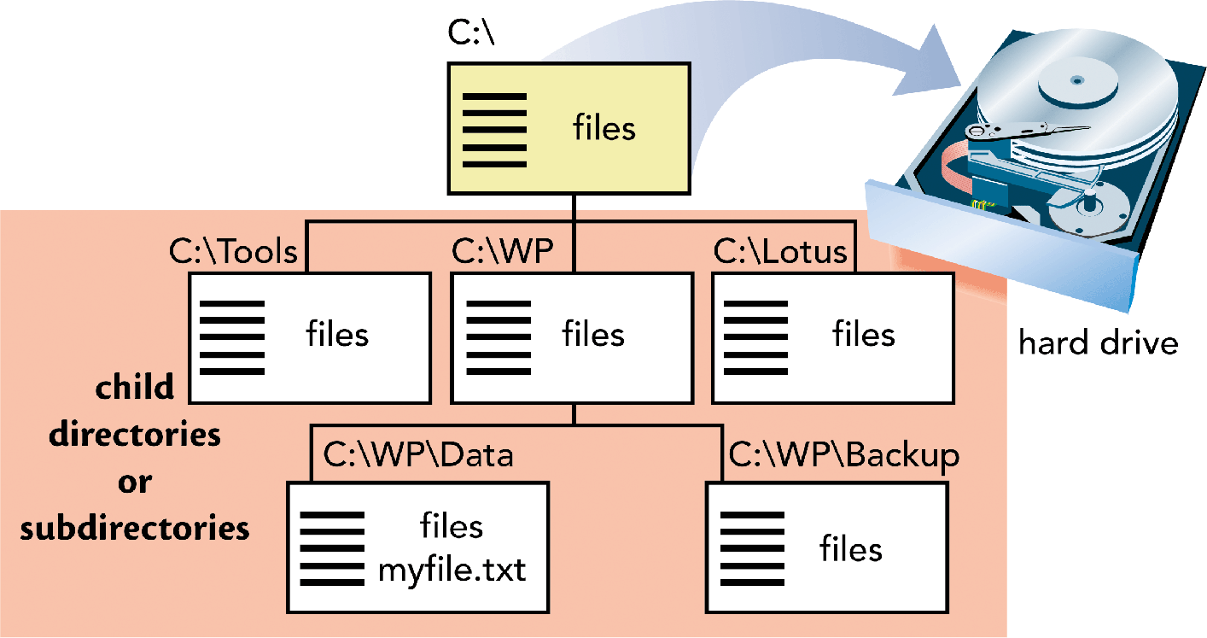
OS and File Management
Operating Systems Internals CMPS254

Slide 5
Files/Directories Path
The path of a file or folder is the location of it within the tree structure
For example the path of the full or absolute path of the Desktop is:
C:\Documents and Settings\Username\Desktop
Operating Systems Internals CMPS254

Slide 6
Types of Files
Files are classified into:
  Text *.txt
  Executable *.exe or *.bat
  Application based
    Excel *.xls
    Document *.doc, *.dot
    PDF Format Doc *.pdf
    Database *.mdb, *.adp
    Ms Visio *.vsd
    Ms publisher *.pub
Operating Systems Internals CMPS254

Slide 7
Types of Files
Graphics
  *.bmp
  *.jpe
  *.jpg
  *.tif
  *.gif
  *.png
Sound *.wav, *.mid,*.au, *.mp3, *.snd ….
Operating Systems Internals CMPS254

Slide 8
Types of Files
Video *.wmv, *.movie, *.avi, *mpg ..
Compressed Files *.jar, *.zip
Other Files are:
  System files *.dll, *.log, *.dat, *.ini, *.tmp ….
  Programming Languages *.c, *.html, *.pl, *.php, *.asp, *.aspx
To view file extensions recognized on your computer:
  Run regedit program and click on HKEY_CLASSES_ROOT
  Right-click My Computer > Explorer > Click on Tools menu > Folder Options > File Types
Operating Systems Internals CMPS254

Slide 9
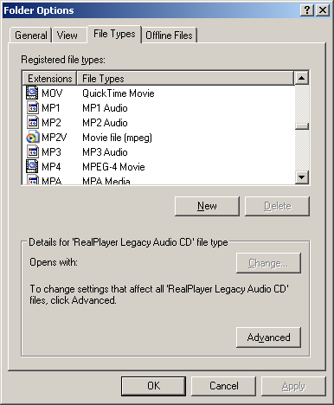
Types of Files
To display the types of files supported by Windows:
Right-click My Computer > Explorer > Click on Tools menu > Folder Options > File Types
Operating Systems Internals CMPS254

Slide 10
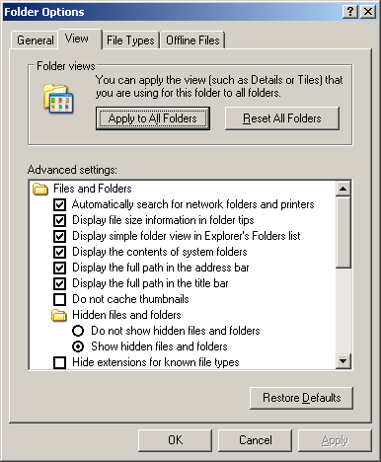
Files Attributes
To display the files attributes:
Right-click My Computer > Explorer > Click on Tools menu > Folder Options > File Types
Operating Systems Internals CMPS254

Slide 11
File Systems Formats
CDFS
UDF
FAT
NTFS
Operating Systems Internals CMPS254
Notes:
Read pages 690-694 from text book

Slide 12

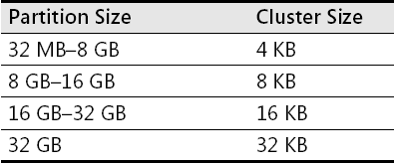
FAT - Format Organization
Default Cluster Sizes for FAT 32 Volumes
Operating Systems Internals CMPS254
Notes:
FAT 32 can address up to 8TB, but Windows limits FAT32 volumes to 32GB.
FAT32 can manage up to 128 volumes with 512 bytes cluster.
FAT32 root directory is not stored in a specific location on the volume.
FAT32 have a copy of boot sector for reliability.
FAT32 disadvantage is maximum file size is 4GB.
Windows XP supports FAT 32 on DVD-RAM devices.

Slide 13
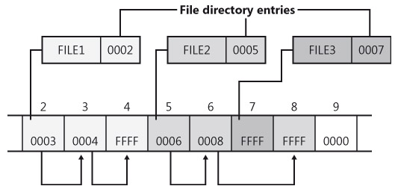
FAT –Directory Entry Example
Operating Systems Internals CMPS254

Slide 14

NTFS Volume
Operating Systems Internals CMPS254
Notes:
NTFS Boot Sector Contains the BIOS parameter block that stores information about the layout of the volume and the file system structures, as well as the boot code that loads Windows Server 2003.
Master File Table Contains the information necessary to retrieve files from the NTFS partition, such as the attributes of a file.
File System Data Stores data that is not contained within the Master File Table.
Master File Table Copy Includes copies of the records essential for the recovery of the file system if there is a problem with the original copy.

Slide 15
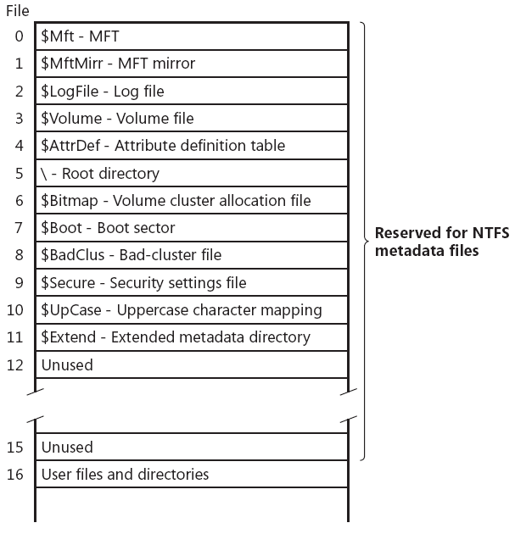
NTFS – Master File Table -MFT
Operating Systems Internals CMPS254
Notes:
Figure 12-24 from text book
In NTFS all data stored in volumes is contained in files to easily locate and maintain the data and each file can be protected by the security descriptor
MFT is implemented as an array of file records
MFT contains one record for each file on the volume, including a record for MFT itself.
MFT metadata start with $. These data is used to implement file system structure
Read Page 733 Master File Table

Slide 16
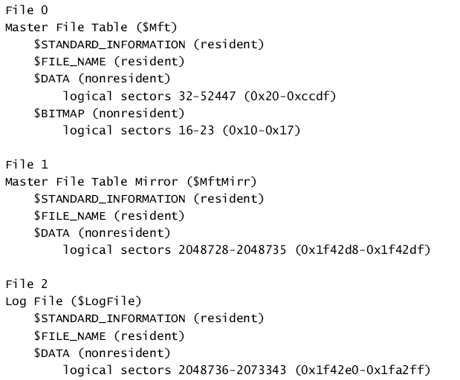
MFT File Records
Operating Systems Internals CMPS254

Slide 17
File Records
NTFS stores files as a Attribute/Value pairs
Each file attribute is stored as a separate stream of bytes within a file
Attributes for NTFS Files e.g
  $FILE_NAME
  $SECURITY_DESCRIPTOR
  $DATA
  $INDEX_ROOT
  $INDEX_ALLOCATION
  $OBJECT_ID
  $EFS
Operating Systems Internals CMPS254

Slide 18
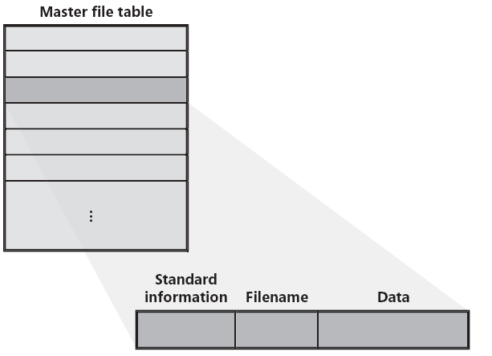
MFT record for a small file
Operating Systems Internals CMPS254

Slide 19
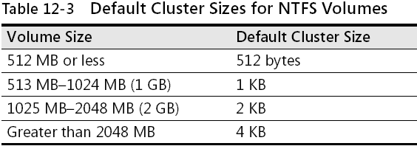
NTFS Volumes
Operating Systems Internals CMPS254
Notes:
When formatting NTFS volumes, you can specify a cluster size of up to 64 KB using the Disk Management snap-in. If you format a volume, but do not specify a cluster size, default values are used. If you want to change the cluster size after the volume is formatted, you must reformat the volume.
Before you choose a cluster size other than the default, note the following important limitations:
•For Microsoft Windows NT, Windows 2000, Windows XP, and Windows Server 2003, the cluster size of FAT16 volumes ranging from 2 gigabytes (GB) through 4 GB is 64 KB, which can create compatibility issues with some applications.
For example, setup programs do not compute free space properly on a volume with 64-KB clusters and cannot run because of a perceived lack of free space. For this reason, you can use either NTFS or FAT32 to format volumes larger than 2 GB.
Because file compression is not supported on cluster sizes greater than 4 KB, the default NTFS cluster size for Windows Server 2003 never exceeds 4 KB.
In theory, the maximum NTFS volume size is 264 clusters minus 1 cluster. However, the maximum NTFS volume size as implemented in Windows Server 2003 is 232 clusters minus 1 cluster.
For example, using 64-KB clusters, the maximum NTFS volume size is 256 terabytes minus 64 KB. Using the default cluster size of 4 KB, the maximum NTFS volume size is 16 terabytes minus 4 KB.

Slide 20
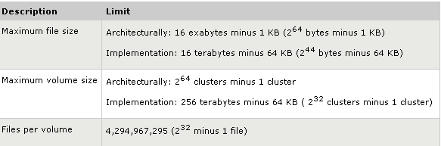
NTFS Size Limitations
Operating Systems Internals CMPS254

Slide 21
NTFS Limitations
Reserved File Names
Maximum Volume Size
Maximum File Size
Alternate Data Streams
Maximum path length
Date range
Operating Systems Internals CMPS254
Notes:
Reserved File Names
Though the file system supports paths up to about 32767 Unicode characters[28] with each path component (directory or filename) up to 255 characters[28] long, certain names are unusable, since NTFS stores its metadata in regular (albeit hidden and for the most part inaccessible) files; accordingly, user files cannot use these names. These files are all in the root directory of a volume (and are reserved only for that directory). The names are: $MFT, $MFTMirr, $LogFile, $Volume, $AttrDef, . (dot), $Bitmap, $Boot, $BadClus, $Secure, $Upcase, and $Extend;[29] . (dot) and $Extend are both directories; the others are files.
Maximum Volume Size
In theory, the maximum NTFS volume size is 264-1 clusters. However, the maximum NTFS volume size as implemented in Windows XP Professional is 232-1 clusters. For example, using 64 KiB clusters, the maximum NTFS volume size is 256 TiB minus 64 KiB. Using the default cluster size of 4 KiB, the maximum NTFS volume size is 16 TiB minus 4 KiB. Because partition tables on master boot record (MBR) disks only support partition sizes up to 2 TiB, dynamic or GPT volumes must be used to create bootable NTFS volumes over 2 TiB.
Maximum File Size
Theoretical: 16 EiB minus 1 KiB (264 − 210 bytes). Implementation: 16 TiB minus 64 KiB (244 − 216 bytes)
Alternate Data Streams
Windows system calls may—or may not—handle alternate data streams.[citation needed] Depending on the operating system, utility and remote file system, a file transfer might silently strip data streams.[citation needed] A safe way of copying or moving files is to use the BackupRead and BackupWrite system calls, which allow programs to enumerate streams, to verify whether each stream should be written to the destination volume and to knowingly skip offending streams.[citation needed]
Maximum path length
An absolute path may be up to 32767 characters[28] long; a relative path is limited to 255 characters.
Date range
NTFS uses the same

Slide 22
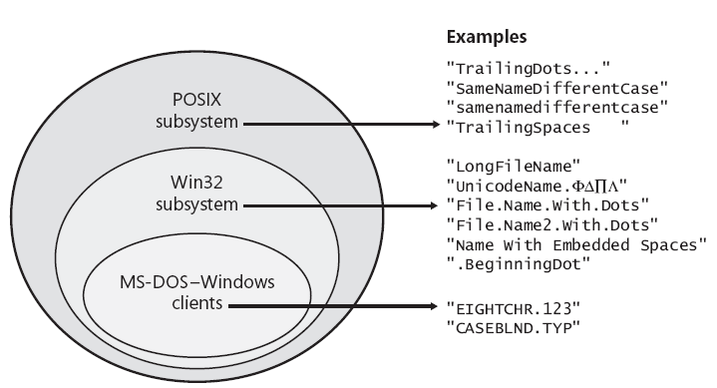
Windows File namespaces
Operating Systems Internals CMPS254

Slide 23
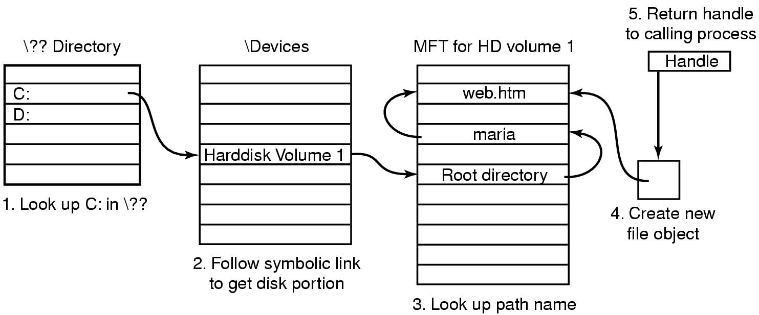
File Name Lookup in W2K
Operating Systems Internals CMPS254
Notes:
When a user program wants to open a file, it typically makes a call like
CreateFile(“C:\maria\web.htm”,…) , this call goes to the user-level shared library, kernel32.dll, where \?? Is appended to the file name giving
\??\C:\maria\web.htm
It is this name that is passed as a parameter to the system call NtFileCreate.
Then the OS starts the search at the root of the object manager’s name space. It then looks in the directory \?? To find C:. This file is a symbolic link to another part of the object manager’s name space, the directory \Device. The link typically ends at an object whose name is something like :
\Device\HarddiskVolume1. This object corresponds to the first partition of the first hard disk. From this object it is possible to determine which MFT to use.
The string ‘maria’ is now looked up in the root directory, which returns the index into the MFT for the directory maria. The directory is then searched for the string “web.htm”. If successful, the result is a new object created by the object manager. The object, which is unnamed, contains the index of the MFT record for the file. A handle to this object is returned to the calling process. On subsequent ReadFile calls, the handle is provided, which allows the object manager to find the index and then the contents of the MFT record for the file.
Reference: Andrew Tanenbaum, Modern Operating Systems

Slide 24
NTFS
Advanced NTFS Features
  Sparse files
  Hard links
  Volume mount points
  Multiple data streams
  All metadata is stored in a regular file
  Large disks and large files
  Quotas -Disk quotas restrict the amount of volume space users take up on remote or local computers with NTFS file systems.
  Security
Operating Systems Internals CMPS254
Notes:
NTFS extends capabilities of FAT file systems by adding:
File system recovery for quick restoration of disk-based data.
Ability to handle large storage media
Security features, including execute-only files.
Unicode filenames.
Support for the POSIX OS.
Features for future extensibility (e.g., transaction-based operations for fault-tolerant applications, user-controlled version numbers, multiple data streams per file, flexible options for file naming/ attributes, and support for popular file servers.)
Windows implements a form of symbolic links called , shortcuts (pointer to files or folders).
The NTFS implements a two- level hierarchy. The contents of short files are kept directly in the file descriptor. For longer files, the descriptor contains lists of block numbers where the actual data is kept.
The native file system , NTFS, of W2K describes each file and each directory using a descriptor of 1 KB. When the number of a file entries (each consisting of a file name and an index to a file descriptor) exceeds the length of the 1 KB descriptor additional block sequences called runs are allocated. The runs are organized in the form of a B+ tree.

Slide 25
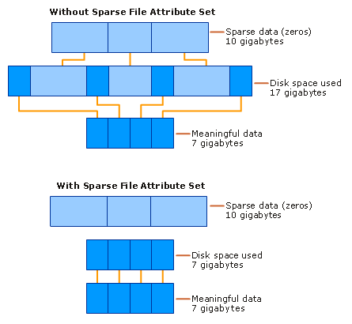
Sparse Files
Operating Systems Internals CMPS254
Notes:
Sparse files provide a method of saving disk space for files that contain meaningful data, as well as large sections of data composed of zeros. If an NTFS file is marked as sparse, then NTFS allocates disk clusters only for the data explicitly specified by the application. Non-specified ranges of the file are represented by non-allocated space on the disk. When a sparse file is read from allocated ranges, the data is returned as it was stored. Data read from non-allocated ranges is returned as zeros.
File system application programming interfaces (APIs) allow for the file to be copied or backed as actual bits and sparse stream ranges.
File system APIs also allow for querying allocated ranges. Programs that implement these APIs then need only to read allocated ranges to recover all data in the file. The result is efficient file system storage and access. The figure Sparse Data Storage shows how data is stored with and without the sparse file attribute set.

Slide 26
Hard Links
A hard link is an NTFS-only based link to a given file. When you create a hard link to a file on an NTFS volume, NTFS adds a directory entry for the hard link without duplicating the original file. By creating hard links you can:
Use the same file name as the original file and appear in different folders.
Use different file names from the original file and appear in the same folder.
Use different file names from the original file and appear in different folders.
Operating Systems Internals CMPS254
Notes:
Because a hard link is a directory entry for a file, an application can modify a file by using any of its hard links. Applications that use any other hard link can detect the changes. However, directory entries for hard links are updated only when a user accesses a file by using the hard link. For example, if a user opens and modifies a file by using its hard link, and the size of the original file changes, the hard link that is used to access the file also shows the new size.
Hard links do not have security descriptors; instead, the security descriptor belongs to the original file to which the hard link points. Thus, if you change the security descriptor of any hard link, you actually change the underlying file’s security descriptor. All hard links that point to the file allow the newly specified access. You cannot give a file different security descriptors on a per-hard-link basis.
Hard links use the Win32 function CreateHardLink to create hard links between files.

Slide 27
Volume Mount Points
Mounted drives, also known as volume mount points or drive paths, are volumes attached to an empty folder on an NTFS volume.
Mounted drives function the same way as any other volume, but are assigned a label or name instead of a drive letter.
Operating Systems Internals CMPS254
Notes:
Mounted drives are robust against system changes that occur when devices are added or removed from a computer. They are not subject to the 26-volume limit imposed by drive letters, so you can use them for access to more than 26 volumes on your computer.
The version of NTFS included with Windows Server 2003 must be used on the host volume. However, the volume to be mounted can be formatted in any file system supported by Windows Server 2003.
One volume can host multiple mounted drives, providing a way for you to easily extend the storage capacity of any particular volume on a Windows Server 2003 system. Users on the local computer or users who connect to it over a network can continue to use the same drive letter for access to the volume, but multiple volumes can be in use simultaneously from that drive letter.
Only NTFS volumes can hold a mounted drive, although any local drive can be mounted on one.

Slide 28
Data Streams
A data stream is a sequence of bytes.
An application populates the stream by writing data at specific offsets within the stream. The application can then read the data by reading the same offsets in the read path.
NTFS supports additional named data streams in which each data stream is an alternate sequence of bytes
Operating Systems Internals CMPS254

Slide 29
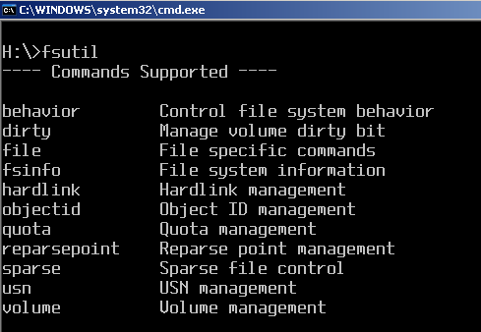
Windows utility - fsutil
Operating Systems Internals CMPS254

Slide 30
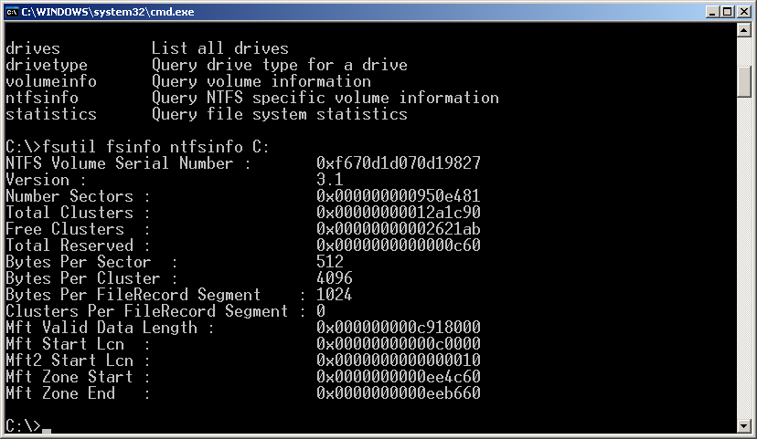
Windows utility - fsutil
Operating Systems Internals CMPS254

Slide 31
Troubleshooting NTFS
chkdsk command
chkntfs command
fsutil utility
Process Monitor – System internals utility
Operating Systems Internals CMPS254

Slide 32
References
SAIT Library e-book 27/7 Mark E. Russinovich and David A. Solomon, “Windows Internals”, Latest Edition, Microsoft Press.
  Chapter 11
    Overview
    Windows File System Formats
    Troubleshooting File System Problems
    NTFS On-Disk Structure
    Encrypting File System Security
Operating Systems Internals CMPS254

Slide 33
References
Silberschatz, Galvin and Gagne, Operating System Concepts with Java, John Wiley & Sons, latest edition.
  Chapter 11 – File-System Implementation
  Chapter 22
    File System
Operating Systems Internals CMPS254

